Slide 1
Amendments requested
by CONSORTIUM

Slide 2
General rules
An amendment to the grant agreement is necessary to change the terms & conditions and annexes of a GA.
The amended provisions become an integral part of the GA. All other provisions remain unchanged and have full effect.
Informal consultation with the PO is welcome beforehand.
Requests must be submitted sufficiently in advance to allow preparation and proper analysis before the changes are due to take effect.
Notes:
Under what circumstances must the Grant Agreement be amended?
If there are any changes to: its terms & conditions (e.g. data or options specific to that agreement) its annexes.
Amended provisions become an integral part of the agreement.

Slide 3
When can an amendment
be requested
Project Life Cycle
Start Eligibility
End Eligibility
Grant Agreement
A M E N D M E N T S
Final Report
Notes:
As soon as the GA is signed by the comission they can do a request until before the end of the project (i.e. the date given in Article 3)
They made a request to the latest legal data
Maybe they want to change the start date.
Exception: In exceptional cases – e.g. if the bank account changes, or the coordinator responsible for paying the balance is replaced – once the project is completed.

Slide 4
Conditions and
procedures
Article 39.1 GA → Conditions: The Agreement may be amended, unless the amendment entails changes which would call into question the decision awarding the grant or breach the principle of equal treatment of applicants;
Article 39.2 GA → Procedure;
For assistance see the H2020 Online manual in the Participant Portal (Support→ H2020 Online manual → grants → grants management → amendments).
Notes:
Amendments: where to find the relevant rules?
39.1 Conditions
The Agreement may be amended, unless the amendment entails changes to the Agreement which
would call into question the decision awarding the grant or breach the principle of equal treatment
of applicants. → Example: if a given number of countries is compulsory in a call, an amendment cannot correspond to a reduction of the minimum number of countries.
Amendments may be requested by any of the parties.
Article 39.2 The party requesting an amendment must submit a request for amendment signed in the electronic exchange system (see Article 36).
The coordinator submits and receives requests for amendment on behalf of the beneficiaries (see
Annex 3).
If a change of coordinator is requested without its agreement, the submission must be done by another
beneficiary (acting on behalf of the other beneficiaries).
The request for amendment must include:
- the reasons why;
- the appropriate supporting documents, and
- for a change of coordinator without its agreement: the opinion of the coordinator (or proof that
this opinion has been requested in writing).
The Commission may request additional information.
If the party receiving the request agrees, it must sign the amendment in the electronic exchange system
within 45 days of receiving notification (or any additional information the Commission has requested).
If it does not agree, it must formally notify its disagreement within the same deadline. The deadline
may be extended, if necessary for the assessment of the request. If no notification is received within
the deadline, the request is considered to have been rejected.
An amendment enters into force on the day of the signature of the receiving party.
An amendment takes effect on the date agreed by the parties or, in the absence of such an agreement,
on the date on which the amendment enters into force.

Slide 5
How To button
Practical assistance
http://ec.europa.eu/research/participants/docs/h2020-funding-guide/grants/grant-management/amendments_en.htm

Slide 6
General conditions
Who
An amendment can be requested by the coordinator of the Consortium (on behalf of the other beneficiaries) or initiated by the Commission (ex. to correct an error made in the GA)
When
Before the end of the project
In the electronic exchange system (Participant Portal)
How
Sign, submit, countersign electronically
Notes:
WHEN
Before the end of the project (i.e. the date given in Article 3)
WHO
The consortium is free to propose amendments.
If you are the coordinator:
Check that the consortium has reached agreement through an internal decision-making process, as set out in the consortium agreement (e.g. unanimously or by simple or qualified majority).
Sign & submit the amendment(s) on its behalf.
Exception According to article 39.2: in cases where coordinators are to be replaced without their agreement, another beneficiary (acting on behalf of the other beneficiaries in the consortium) submits the request.
The Commission can also propose amendments.
HOW
Prepare your request using the Participant Portal's Grant Management Service.
2) The requesting party signs and submits amendments electronically.
3)The receiving party countersigns the amendments electronically.

Slide 7
When is an amendment necessary?
Termination, addition or replacement of a beneficiary (or coordinator)
Budget transfer of more than 20 % of the total costs (Art. 4.2 GA)
Additional subcontracting
Change in work packages and deliverables (changes to Annex 1 of GA)
Transfer of tasks between beneficiaries
Change of the bank account

Slide 8
When amendments are NOT necessary?
Change of address of a beneficiary or coordinator;
Change in the name of the bank or in the address of the branch where the coordinator has an account;
Change of VAT number etc.
This kind of changes are:
introduced by the LEAR of the beneficiary concerned via the Participant Portal (MO – My organisation);
visible to Project Officer under the tab «amendment information».

Slide 9
Request for amendment
1. Launch the amendment request in the Participant Portal
(Pre-requisite: GA signed by the EU)
2. Compose the amendment
3 documents will be generated automatically:
Amendment Request Letter
Amendment Core Letter
Grant Agreement Data Sheet
3. Consultation of the EU Project Officer
(an “unofficial” review by the PO is strongly recommended);
4. Sign & Submit the amendment request to EC
Admissibility checks/Assessment → E-Signature or rejection
Notes:
Generated documents
Amendment core → general information and references to all changes; This document will be the core document that will contain all the signatures
Amendment request letter → includes justification and changes
Grant agreement data sheet → If we know the GAP, there is a grant agreement data sheet. It gives 2/3 pages with the key elements of the project. It is really important. This document gives a good overview.
+ annexes which are being changed

Slide 10
CONSORTIUM
EC OFFICERS
Cancel
the
amendment
Withdraw
the
amendment
LAUNCH & COMPOSE
Lock
Review the request
Submit request to EU Services (signature)
45 days clock
Visas
+
Sign
Signed Amendment
REMINDER:
ALWAYS CONSULT
the
Project Officer
Admissibility Check
Assessment
Reset 45 days
Warning: the PO cannot change the amendment at this stage!
Receive Documents
Ask for additional information
Upload/Send documents

Slide 11
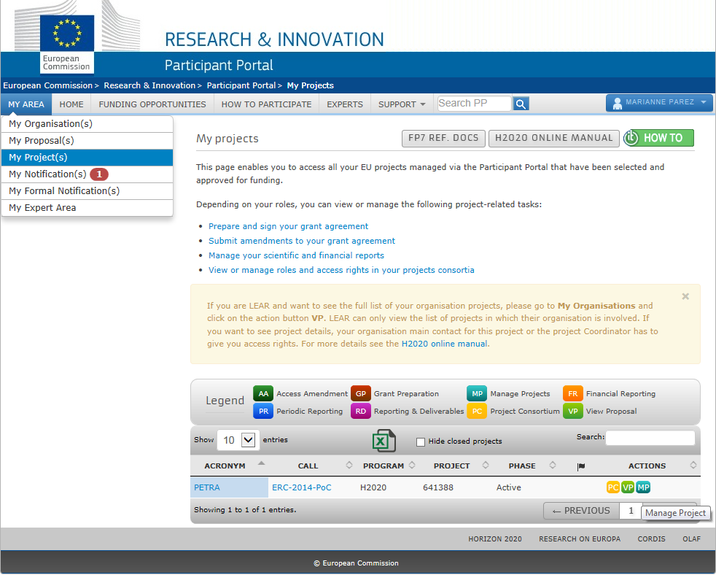
Step 1
LAUNCH THE AMENDMENT
EU LOGIN
(1)
(2)
(3)
XXXX

Slide 12
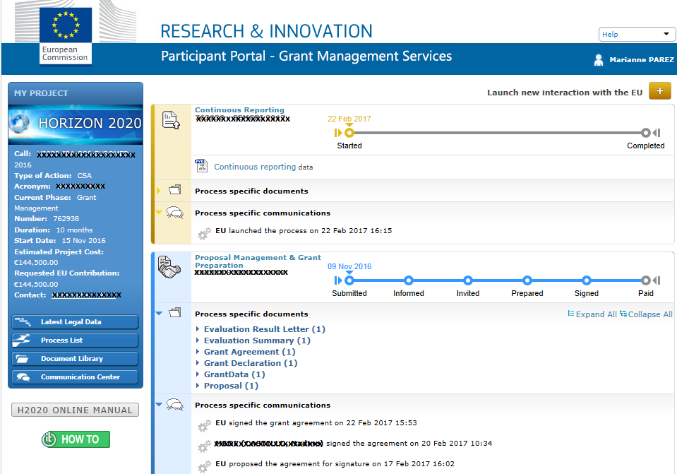
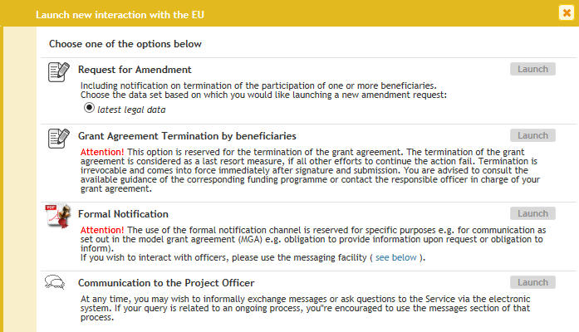
Step 1
LAUNCH THE AMENDMENT
(4)
XXXXX

Slide 13
Step 1
LAUNCH THE AMENDMENT
5) Wait until you receive an e-mail telling you that your session is open;
6) Click on the link “My Project”
(6)

Slide 14
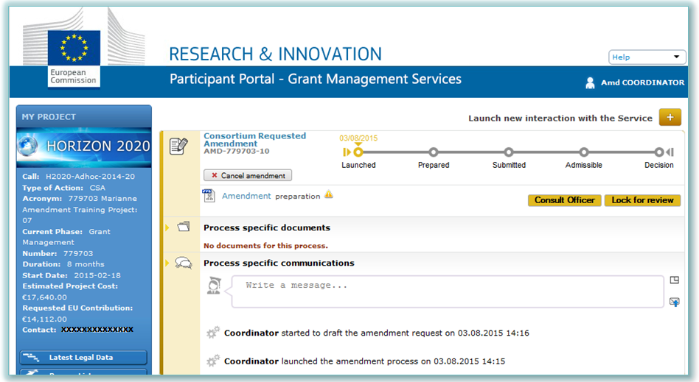
Step 1
LAUNCH THE AMENDMENT
7) Click on “Amendment preparation”
(7)
XXXXXXXXXXXX
XXXXXXXXXXX
XXXXXX

Slide 15
Step 2
COMPOSE
Click on the Amendment preparation and access “Amendment information” tab to add the justification which will be included in the Request Letter;
Most clauses will be automatically selected based on modified data. Other clauses should first be ticked by the project officer (e.g. change in Annex 1, changes in the budget);
Amend the relevant data by clicking in one of the tabs (such as “Beneficiaries”, “General information”, “Financial Information”, “Work packages” , “Deliverables”, “Risks”);
Upload annexes & relevant supporting documents (depending on the type of amendment);
Make sure the necessary validations are complete (e.g. validation of a new legal entity or bank account);
If you click on the “Amendment information” tab and then on “documents”, you will find the amendment core, the amendment request letter and the GA data sheet which are automatically generated;
You can check all the amendments in the “Project summary” tab.

Slide 16
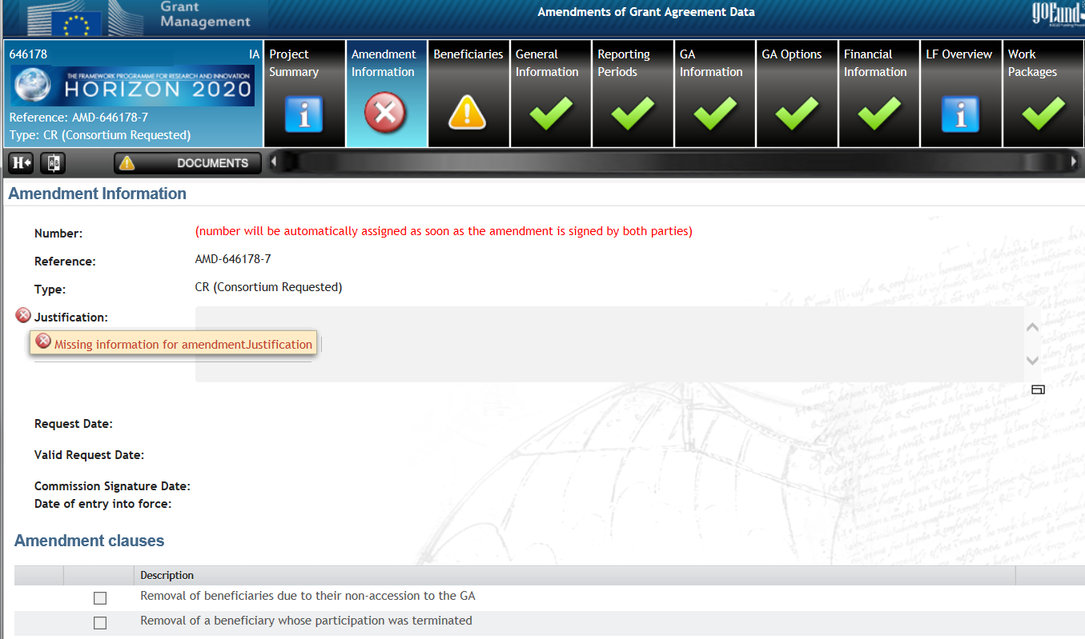
Step 2
Edit full amendment data
Notes:
They need to give to us a justification. For each of the changes they will encode they need a justification. They can write more than two pages.
If they send 5 changes, for each, an explanation.
Two documents are created
Add new beneficiary
Termination of beneficiary
Remove third party
Change technical aneex
Deliverables…
All the changes are below. What they need to do, they do the changes in the related in the tab.

Slide 17
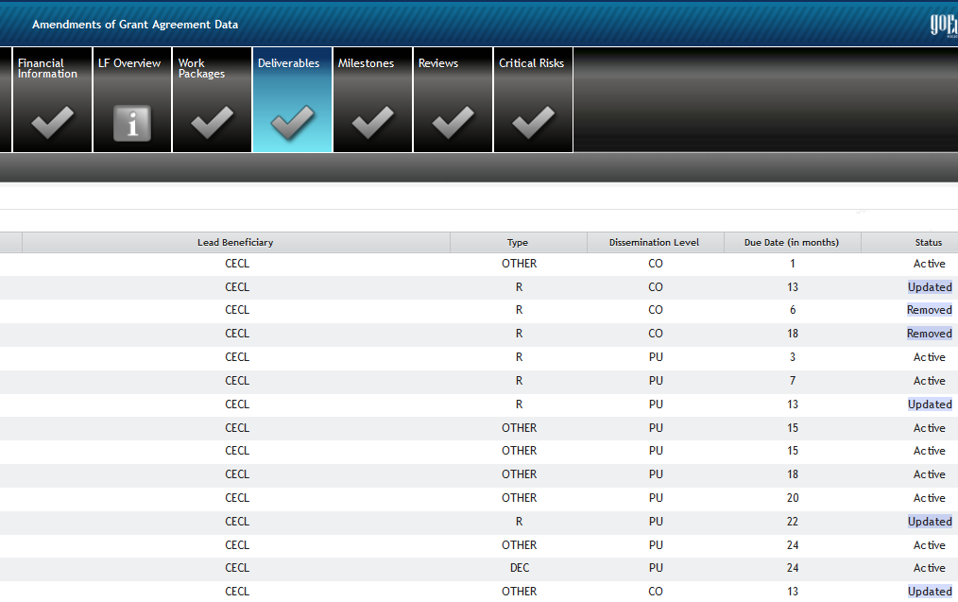
Step 2
Edit full amendment data
Partner 1
Partner 1
Partner 2
Partner 1
Partner 3
Partner 1
Partner 1
Partner 3
Partner 2
Partner 1
Partner 1
Partner 1
Partner 1
Partner 1
Partner 1

Slide 18
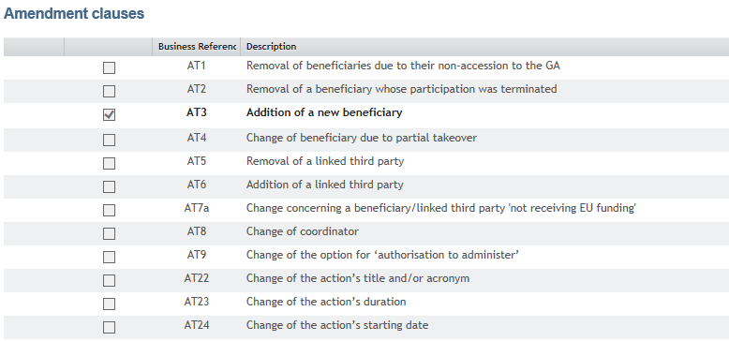
Amendment clauses automatically selected
Step 2
Notes:
On the basis of the changes to the grant agreement data, the relevant types of amendment are selected automatically from the predefined list. Example: if the user adds a new beneficiary, the following amendment types are selected automatically: 'Addition of one or more beneficiaries', 'Amendment to Annex 1' and 'Amendment to Annex 2'.
Other types of amendment are selected manually, e.g. 'Change in the maximum grant amount', 'Retraction of project suspension', 'Amendment to Annex 1'.

Slide 19
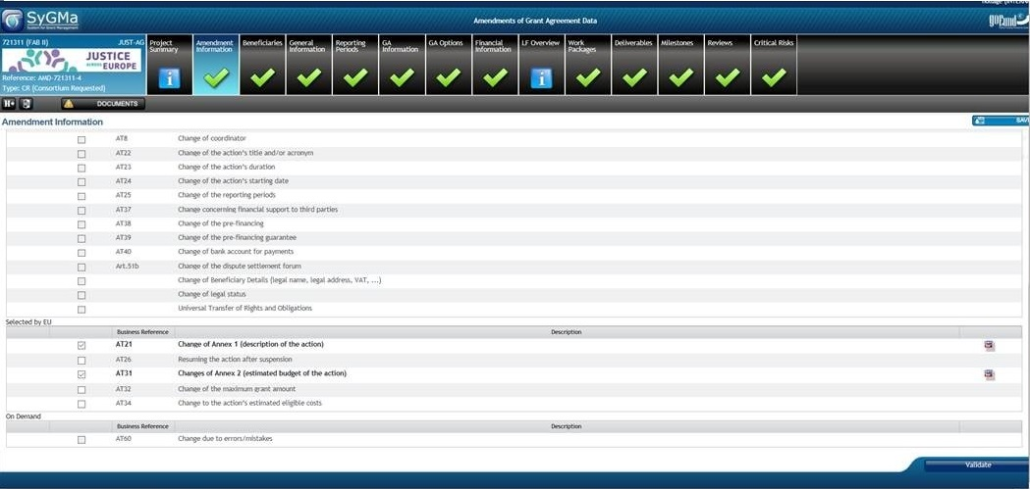
Ex. of amendment clauses which need to be selected/opened by the PO
Step 2
COMPOSE
Notes:
To select/unselect a manual Grant Agreement option or a manual amendment type (e.g. change of Annex 1 and change of Annex 2), you have to ask the EU Officer.

Slide 20
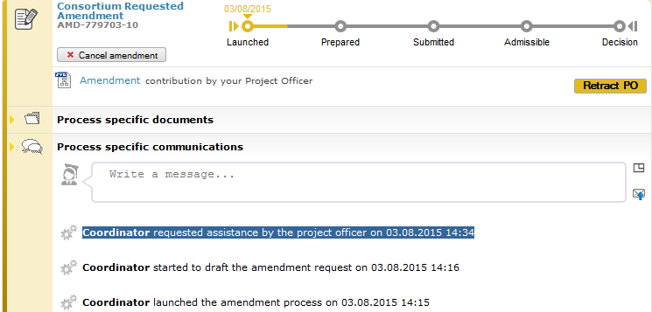
Step 3
Consult the Project Officer
Consortium can ask the EU Officer to "unofficially" review the amendment → The PO is notified

Slide 21
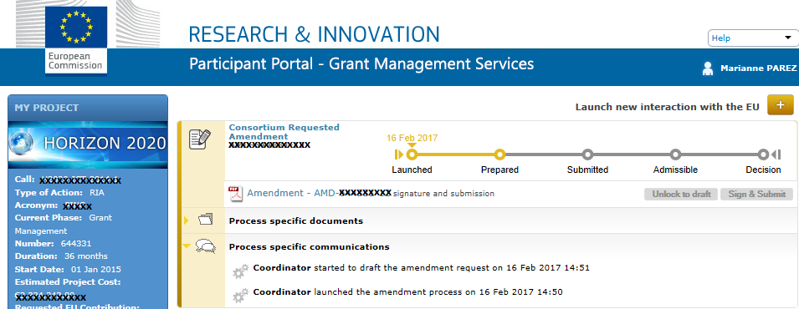
SIGN & SUBMIT
Data locked
for review
Step 4
Notes:
The coordinator locks for review (data locked)→ Pdf generated

Slide 22
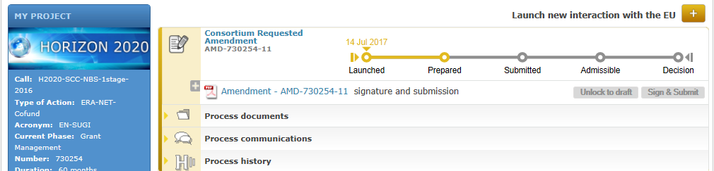
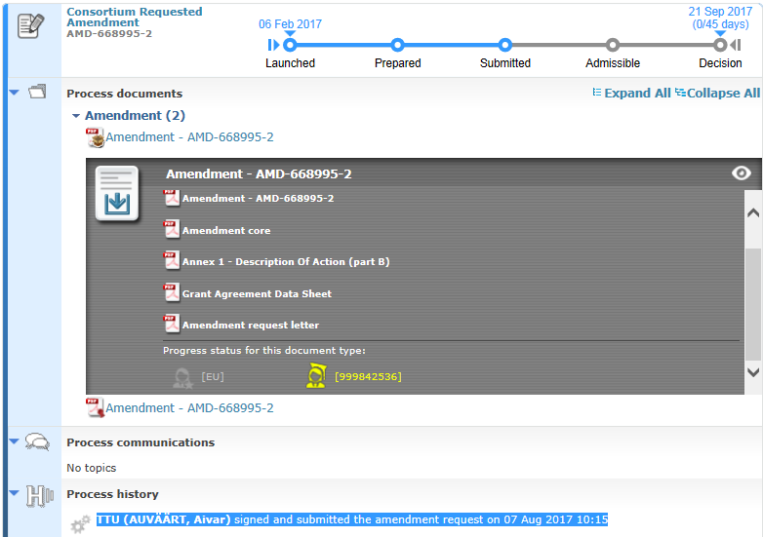
Step 4
SIGN & SUBMIT
Signature by PLSIGN
Notes:
The authorised project legal signatory (PLSIGN) must then e-sign the request

Slide 23
EC assessment
The Commission can accept or reject the request within 45 days (only exceptionally extended);
The Commission may also request additional information/documents, which must not change the amendment itself → you must upload request information within 15 days or → rejection;
Tacit rejection if no reaction within 45 days deadline.
Notes:
The Commission assesses the request
The Commission must now accept or reject the request within 45 days. It sends the coordinator a formal notification through the Participant Portal.
Firstly, it checks whether the request is valid – does it include all supporting documents and explanations? It may request additional information/documents, which must not change the amendment itself.
As coordinator, make sure you upload any further information requested within 15 calendar days of receiving the Commission's request. If you do not do so, the Commission will reject your request.
The Commission now has 45 days to assess the request.
Deadline extension: the deadline may - exceptionally - be extended on a discretionary basis, e.g. if the amendments are complex, specific compliance checks are needed (e.g. on ethical issues), or if the project has to be reviewed to assess the changes).
As coordinator, you cannot alter a request for an amendment once it has been e-signed and submitted. There are 2 options:
You withdraw it.
The Commission rejects it.
If you do not receive a notification within the 45-day deadline, the request is considered to have been rejected (tacit rejection). Horizon 2020 has no system for approving amendments tacitly. You must now contact the Commission (i.e. the project officer). The rejected request is saved so that you can reuse it to submit a new request that repeats the initial one fully or in part.

Slide 24
Entry into force
The amendment is legally binding and will be incorporated into the grant agreement;
An amendment proposed by a consortium enters into force on the day the Commission signs it;
It takes effect either on a specific date agreed by the parties or on the date it enters into force (only exceptionally retroactively);
If a request involves more than one change, these can take effect on different dates;
It may affect the eligibility of costs.
Notes:
An amendment proposed by a consortium enters into force on the day the Commission signs it.
It takes effect (i.e. the changes to the grant agreement start to apply) either:
on a specific date agreed by the parties (clearly specified in the amendment), or
on the date it enters into force (i.e. the date on which the amendment was last signed).
This date should normally be after the entry into force. In justified cases it may – exceptionally - be before that date (retroactive).
Example: the grant agreement states that amendments take effect before they enter into force if the implementation of the project is suspended (Article 49.2.2).
If a request involves more than one change, these can take effect on different dates.
Example Amendment changing the bank account and adding a new linked third party:
The change of bank account takes effect on the date of the amendment's entry into force.
The addition of the linked third party takes effect on a specific date stated in the amendment.
Depending on the nature of the amendment, the date on which it takes effect may affect the eligibility of costs.
Example If a beneficiary is added, costs are eligible from the 'accession date' specified in the Accession Form (Annex 3).

Slide 25
Cancelation/
withdrawal
Notes:
Can be done only by PLSIGN
REMINDER: there is the possibility to cancel/withdraw the amendment at any moment (before EU signature)
As coordinator, you can withdraw a submitted request, provided that the Commission has not approved it. Withdrawn requests are saved and can be reused to submit a new request.
If there is an error, we ask them to cancel and they have to launch a new one. If they don’t want to cancel, we have to reject. (Compose rejection letter). Three persons are involved (PO, OV and the person signing). The best escenario m We as PO are in admissibility check or assessment , is that they cancel.

Slide 26
Resources
H2020 Online Manual
How to button
Consult your Project Officer

