Slide 1
DG Justice and Consumers
How to implement a project successfully
September 2018
DG Justice and Consumers

Slide 2
Communicate
Until the final payment: via the participant portal
After the final payment: by post (cf. Art. 36 GA)
Update us on the progress of implementation
Dare to ask questions
Anticipate problems
Be open/honest in your reports

Slide 3
The coordinator and all co-beneficiaries shall
Read the Grant Agreement
Read the Guide for Applicants for Action Grants 2016
http://ec.europa.eu/research/participants/portal/desktop/en/funding/reference_docs.html#other
Take the time to consult the H2020 manual and the little green button
http://ec.europa.eu/research/participants/docs/h2020-funding-guide/index_en.htm

Slide 4
The coordinator and all co-beneficiaries shall also
Make appropriate internal arrangements -> Consortium Agreement (Art. 25.3 GA)
Record expenses regularly
Record all project-related expenses (Excel table available in the Reference Documents or your own tools)

Slide 5
EU-funding visibility - art. 22 GA
Systematically mention on all materials and communication activities "Co-funded by the Rights, Equality and Citizenship Programme of the European Union (2014-2020)” next to the EU emblem.
A guide "The use of the EU emblem in the context of EU programmes" is available on: http://ec.europa.eu/dgs/communication/services/visual_identity/pdf/use-emblem_en.pdf

Slide 6
EU-funding visibility
But not this logo
Examples: Supported by the Rights, Equality and Citizenship programme of the
European Union
This project is funded by the Rights, Equality and Citizenship Programme of the European Union

Slide 7
EU-funding visibility
Any communication activity must indicate the following “Disclaimer” (art. 22.1.3 GA):
"The content of this [insert appropriate description, e.g. report, publication, conference, etc.] represents the views of the author only and is his/her sole responsibility. The European Commission does not accept any responsibility for use that may be made of the information it contains."
If you have any technical questions regarding the use of the EU emblem in the context of EU programmes, please write to: comm-visual-identity@ec.europa.eu
EU flag: https://europa.eu/european-union/about-eu/symbols/flag_en

Slide 8
Ownership of the results, Art. 19.2 GA
The result of the action is owned by the beneficiaries
The Commission has the right to use the project’s results for its communication activities
Publication only if result/deliverable has been classified « public »

Slide 9
Budget transfers – art. 4.2 GA
The estimated budget may be adjusted — without an amendment — by transfers of amounts between beneficiaries and/or budget categories, if the action is implemented as described in Annex 1 of the GA. However :
the transfers between budget categories must stay below 20% of the total costs, otherwise an amendment is needed
If subcontracting costs are added, an amendment is needed

Slide 10
Transfer of costs but not tasks
Transfer of costs between partners are allowed (within limits of art 4.2 GA)
If you wish a transfer of tasks between partners, an amendment is needed

Slide 11
Eligibility of costs, Art. 6
Personnel costs
In the periodic reporting (= Final Report) staff costs are to be reported as follows: Person/months per work package per beneficiary
For correct calculation of staff costs and requirements regarding timesheets see
Art. 6 GA “Eligible and ineligible costs”
Guide for Applicants, “Annex on Eligibility of costs”, ”2. Detailed provisions on eligible expenditure”, including list of supporting documents

Slide 12
Eligibility of costs, Art. 6
Other direct costs
Equipment -> only depreciation costs are eligible
Costs of renting and leasing equipment -> eligible if they do not exceed the depreciation costs of similar equipment
Costs of other goods and services -> eligible if purchased specifically for the action (e. g. consumables and supplies, translations, publications etc.)

Slide 13
Eligibility of costs, Art. 6
Indirect costs
Up to a maximum of 7 %
Not for beneficiaries receiving an operating grant

Slide 14
Subcontracting (art. 10 GA)
Subcontracting: implementation by a third party of tasks forming part of the action as described in Annex I of the grant agreement
Budget heading C
≠
Implementation contract: procurement of ordinary services, goods or equipment needed to carry out the project (e.g. translations, renting of rooms, reproduction of communication material)
Budget heading E

Slide 15
Subcontracting (art. 10 GA)
May cover only limited part of the action, best value for money or if appropriate the lowest price, no conflict of interests
Applicable national law on public procurement (for Public Bodies)
The beneficiaries must ensure that the sub-contracted work is performed in one of the eligible countries set out in the call for proposals

Slide 16
VAT for Public Bodies
Activities engaged in as public authority -> VAT ineligible
Public power prerogatives which can only be exercised by public bodies under their special legal framework (e. g. powers of police, powers of justice etc.
Examples can be found in the Guide for Applicants, “Annex on Eligibility of Costs”, point 1.4.3

Slide 17
Exchange rate (art. 15.6 GA)
One single average rate for the project, calculated over the corresponding reporting period
This link provides average exchange rates:
http://www.ecb.europa.eu/stats/policy_and_exchange_rates/euro_reference_exchange_rates/html/index.en.html

Slide 18
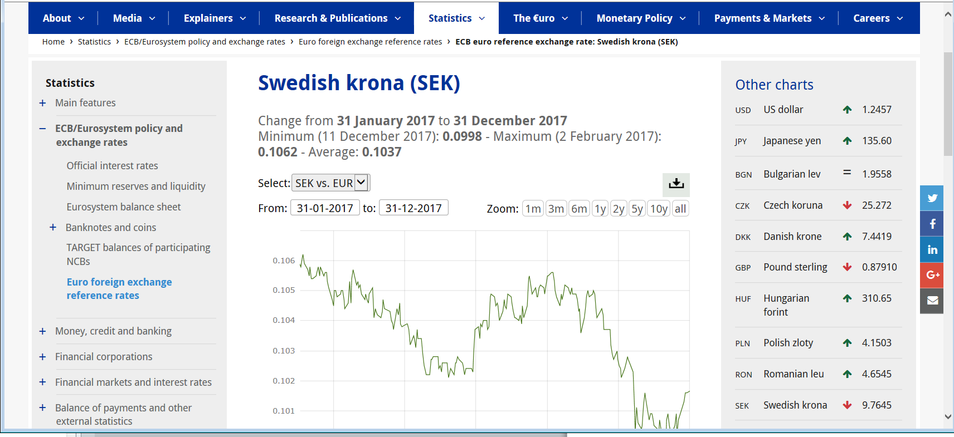
Average exchange rate
1 – click on the chart icon
2 – indicate a time frame

Slide 19
Main reasons for rejection of costs
Lack of supporting documents (e.g. timesheets)
Claimed costs do not match supporting documents
Costs claimed for activities outside eligibility period or not linked to the activities
Claimed costs are not invoiced to one of the beneficiaries
Staff costs wrongly calculated
No mention of EU funding

Slide 20
Checks, reviews and audits – GA, art. 17
Checks: Example: after receiving the reports, the Commission checks supporting documents. Also, the Commission regularly performs verifications on potential double-funding and plagiarism.
Reviews: (on-the-spot) reviews normally refer mainly the technical implementation of the project (i.e. its scientific and technological relevance), but may also cover financial and budgetary aspects. Reviews may be started up to 5 years after the payment of the balance and may include on-the-spot visits or review meeting (on Commission premises or anywhere relevant for the project).
Audits (on the proper implementation of the action and compliance with the obligations under the Agreement): up to 5 years after payment of the balance.
Remember your obligation to keep records and other supporting documentation for up to five years after payment of the balance (Art. 13 GA)

