Slide 1
How to amend the Grant Agreement?

Slide 2
Project Life Cycle
Start Eligibility
End Eligibility
Grant Agreement
A M E N D M E N T S
Final Report

Slide 3
An amendment to the grant agreement is necessary to change the terms and conditions of a GA;
Consequences→ The amended provisions become an integral part of the GA. All other provisions remain unchanged and have full effect;
Requests must be submitted sufficiently in advance to allow preparation and proper analysis before the changes are due to take effect.

Slide 4
Amendments: where to find the relevant rules?
Article 39.1 GA → Conditions: The Agreement may be amended, unless the amendment entails changes which would call into question the decision awarding the grant or breach the principle of equal treatment of applicants;
Article 39.2 GA → Procedure;
For assistance see the H2020 Online manual in the Participant Portal (Support→ H2020 Online manual → grants → grants management → amendments). Further practical assistance can be found by clicking on
Notes:
39.1 Conditions
The Agreement may be amended, unless the amendment entails changes to the Agreement which
would call into question the decision awarding the grant or breach the principle of equal treatment
of applicants.
Amendments may be requested by any of the parties.
Article 39.2 The party requesting an amendment must submit a request for amendment signed in the electronic exchange system (see Article 36).
The coordinator submits and receives requests for amendment on behalf of the beneficiaries (see
Annex 3).
If a change of coordinator is requested without its agreement, the submission must be done by another
beneficiary (acting on behalf of the other beneficiaries).
The request for amendment must include:
- the reasons why;
- the appropriate supporting documents, and
- for a change of coordinator without its agreement: the opinion of the coordinator (or proof that
this opinion has been requested in writing).
The Commission may request additional information.
If the party receiving the request agrees, it must sign the amendment in the electronic exchange system
within 45 days of receiving notification (or any additional information the Commission has requested).
If it does not agree, it must formally notify its disagreement within the same deadline. The deadline
may be extended, if necessary for the assessment of the request. If no notification is received within
the deadline, the request is considered to have been rejected.
An amendment enters into force on the day of the signature of the receiving party.
An amendment takes effect on the date agreed by the parties or, in the absence of such an agreement,
on the date on which the amendment enters into force.

Slide 5
Who? When? How?
Who
An amendment can be requested by the coordinator of the Consortium (on behalf of the other beneficiaries) or initiated by the Commission (ex. to correct an error made in the GA)
When
Before the end of the project
In the electronic exchange system (Participant Portal)
How
Sign, submit, countersign electronically
Notes:
WHEN
Before the end of the project (i.e. the date given in Article 3)
WHO
The consortium is free to propose amendments.
If you are the coordinator:
Check that the consortium has reached agreement through an internal decision-making process, as set out in the consortium agreement (e.g. unanimously or by simple or qualified majority).
Sign & submit the amendment(s) on its behalf.
Exception According to article 39.2: in cases where coordinators are to be replaced without their agreement, another beneficiary (acting on behalf of the other beneficiaries in the consortium) submits the request.
The Commission can also propose amendments.
HOW
Prepare your request using the Participant Portal's Grant Management Service.
2) The requesting party signs and submits amendments electronically.
3)The receiving party countersigns the amendments electronically.

Slide 6
Cases where an amendment is necessary (some examples)

Slide 7
NECESSARY WHEN
Additional sub contracting
Termination, addition or replacement of a beneficiary (or coordinator)
Change of the bank account
Transfer of tasks between beneficiaries
Change in work packages and deliverables (changes to Annex 1 of GA)
Budget transfer of more than 20 % of the total costs (Art. 4.2 GA)

Slide 8
No amendment for changes related to the organisation
Change of address of a beneficiary or coordinator;
Change in the name of the bank or in the address of the branch where the coordinator has an account;
Change of VAT number etc.
This kind of changes are:
introduced by the LEAR of the beneficiary concerned via the Participant Portal (MO – My organisation);
visible to Project Officer under the tab «amendment information».

Slide 9
CONSORTIUM REQUEST FOR AMENDMENT: 4 STEPS
1. Launch the amendment request in the Participant Portal
(Pre-requisite: GA signed by the EU)
2. Compose the amendment
3 documents will be generated automatically:
Amendment Request Letter
Amendment Core Letter
Grant Agreement Data Sheet
3. Consultation of the EU Project Officer (an “unofficial” review of the PO is strongly recommended);
4. Sign & Submit the amendment request to EC
Admissibility checks/Assessment → E-Signature or rejection

Slide 10
CONSORTIUM
EU OFFICERS
Cancel
the
amendment
Withdraw
the
amendment
LAUNCH & COMPOSE
Lock
Review the request
Submit request to EU Services (signature)
45 days clock
Visas
+
Sign
Signed Amendment
REMINDER:
ALWAYS CONSULT
the
Project Officer
Admissibility Check
Assessment
Reset 45 days
Warning: the PO cannot change the amendment at this stage!
Receive Documents
Ask for additional information
Upload/Send documents

Slide 11
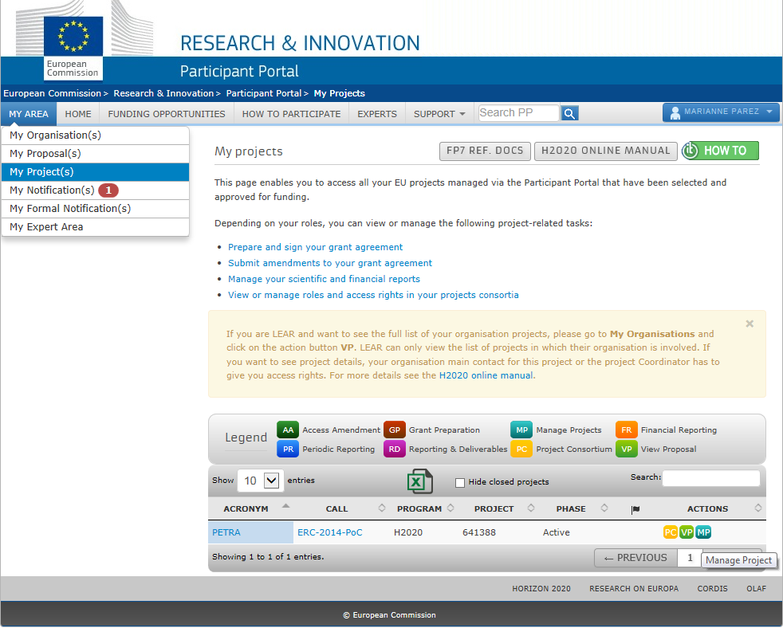
Step 1
LAUNCH THE AMENDMENT
EU LOGIN
(1)
(2)
(3)
XXXX

Slide 12
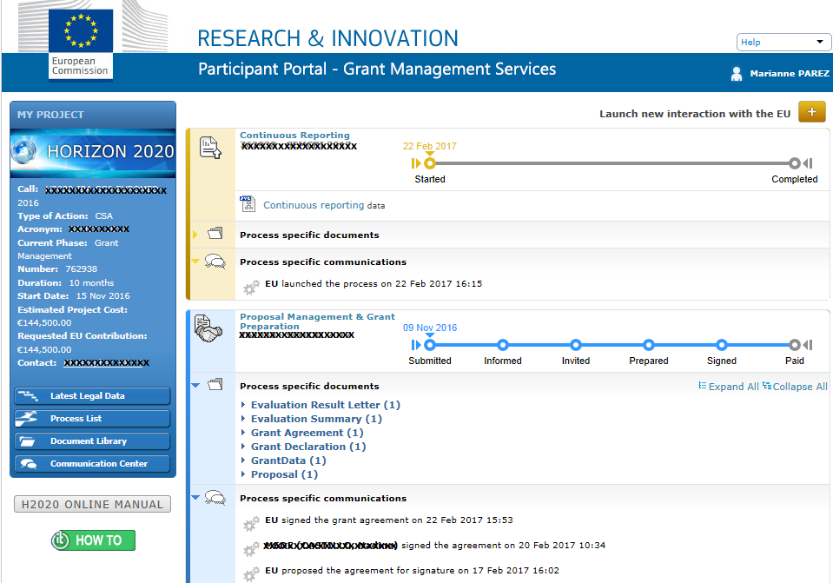
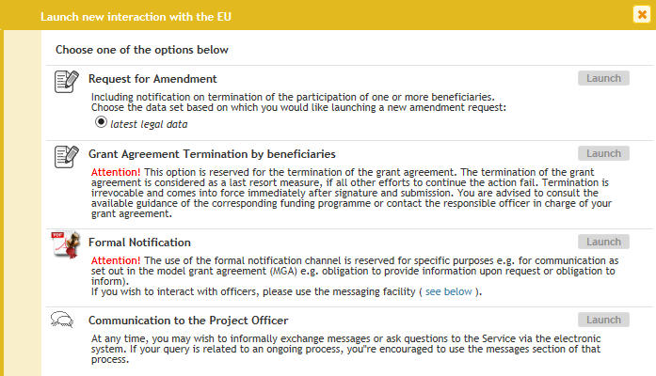
(4)
XXXXX

Slide 13
5) Wait until you receive an e-mail telling you that your session is open;
6) Click on the link “My Project”
(6)

Slide 14
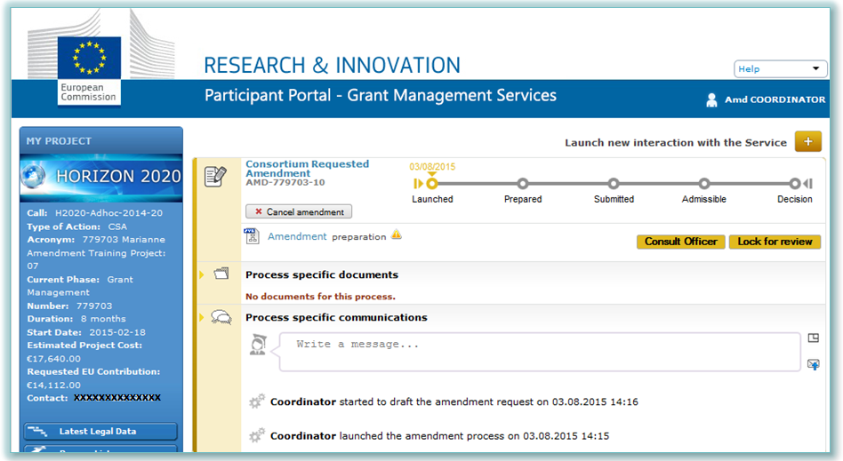
7) Click on “Amendment preparation”
(7)
XXXXXXXXXXXX
XXXXXXXXXXX
XXXXXX

Slide 15
COMPOSE THE AMENDMENT
Step 2
COMPOSE
1) Click on “Amendment preparation”. Amend the relevant data by clicking in one of the tabs (such as “Beneficiaries”, “General information”, “Reporting Periods”, “GA options” etc.);
2) Click on the “Amendment information” tab. Most clauses are automatically selected based on the data that you have modified. Other clauses are ticked by the project officer (e.g. change in annex 1, changes in the budget) (see next slides);
3) You can now add the justification and be aware that it will be included in the Request Letter;
4) Upload annexes & relevant supporting documents (depending on the type of amendment);
5) Make sure the necessary validations are complete (e.g. validation of a new legal entity or bank account);
6) If you click on the “Amendment information” tab and then on “documents”, you will find the amendment core, the amendment request letter and the GA data sheet which are automatically generated;
7) You can check all the amendments in the “Project summary” tab.

Slide 16
Ex. of amendment clauses automatically selected

Slide 17
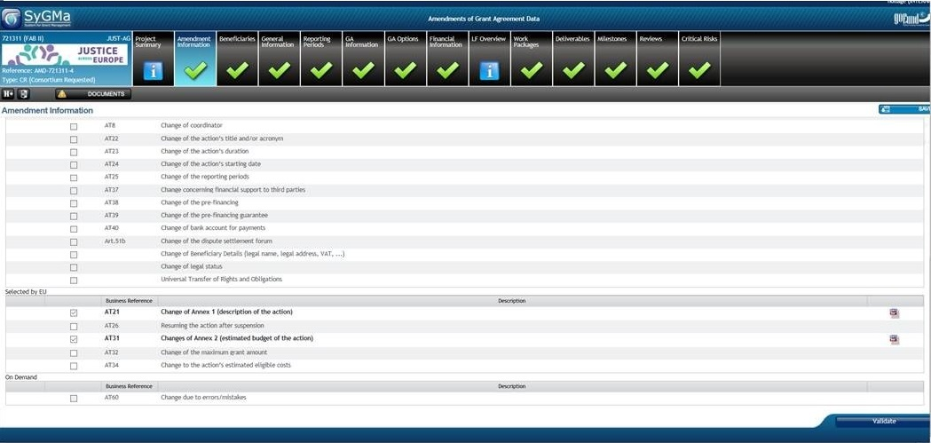
Ex. of amendment clauses which need to be selected/opened by the PO

Slide 18
Step 3
CONSULT
CONSULT THE PROJECT OFFICER
during the amendment request preparation
(strongly recommended)

Slide 19
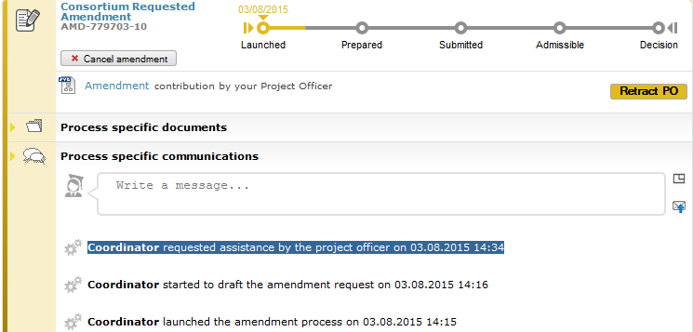
Consortium can ask the EU Officer to "unofficially" review the amendment → The PO is notified

Slide 20
Step 4
SIGN & SUBMIT
SIGN & SUBMIT the amendment to EC

Slide 21
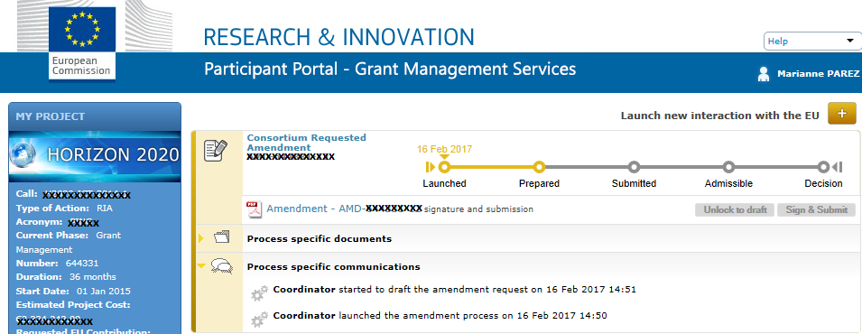
1) The coordinator locks for review (data locked)→ Pdf generated
XXXXXX

Slide 22
2) Your authorised project legal signatory (PLSIGN) must then e-sign the request

Slide 23
3) The Commission assesses the request
The Commission can accept or reject the request within 45 days (only exceptionally extended);
The Commission may also request additional information/documents, which must not change the amendment itself → you must upload request information within 15 days or → rejection;
Tacit rejection if no reaction within 45 days deadline.
Notes:
The Commission must now accept or reject the request within 45 days. It sends the coordinator a formal notification through the Participant Portal.
Firstly, it checks whether the request is valid – does it include all supporting documents and explanations? It may request additional information/documents, which must not change the amendment itself.
As coordinator, make sure you upload any further information requested within 15 calendar days of receiving the Commission's request. If you do not do so, the Commission will reject your request.
The Commission now has 45 days to assess the request.
Deadline extension: the deadline may - exceptionally - be extended on a discretionary basis, e.g. if the amendments are complex, specific compliance checks are needed (e.g. on ethical issues), or if the project has to be reviewed to assess the changes).
As coordinator, you cannot alter a request for an amendment once it has been e-signed and submitted. There are 2 options:
You withdraw it.
The Commission rejects it.

Slide 24
4) Entry into force
The amendment is legally binding and will be incorporated into the grant agreement;
An amendment proposed by a consortium enters into force on the day the Commission signs it;
It takes effect either on a specific date agreed by the parties or on the date it enters into force (only exceptionally retroactively);
If a request involves more than one change, these can take effect on different dates;
It may affect the eligibility of costs.
Notes:
An amendment proposed by a consortium enters into force on the day the Commission signs it.
It takes effect (i.e. the changes to the grant agreement start to apply) either:
on a specific date agreed by the parties (clearly specified in the amendment), or
on the date it enters into force (i.e. the date on which the amendment was last signed).
This date should normally be after the entry into force. In justified cases it may – exceptionally - be before that date (retroactive).
Example: the grant agreement states that amendments take effect before they enter into force if the implementation of the project is suspended (Article 49.2.2).
If a request involves more than one change, these can take effect on different dates.
Example Amendment changing the bank account and adding a new linked third party:
The change of bank account takes effect on the date of the amendment's entry into force.
The addition of the linked third party takes effect on a specific date stated in the amendment.
Depending on the nature of the amendment, the date on which it takes effect may affect the eligibility of costs.
Example If a beneficiary is added, costs are eligible from the 'accession date' specified in the Accession Form (Annex 3).

Slide 25
REMINDER: there is the possibility to cancel/withdraw the amendment at any moment (before EU signature)

Slide 26
Thank you for your attention!
Questions?

