Slide 1
DG Justice and Consumers
Kick-off meeting – 26 September 2018
For projects of the call REC-RDAT-TRAI-AG-2016
« Support training activities on the data protection reform »
Organised by Unit JUST.C3 Data Protection
And Unit JUST.04 Programme and Financial Management
DG Justice and Consumers

Slide 2
AGENDA
08:55 – 09:15 Registration of participants
09:15 – 09:25 Welcome and Introduction by EC
09:25 – 10:30 Continuous & periodic reporting
10:30 – 10:50 Coffee break
10:50 – 11:30 Amendments
11:30 – 12:00 Administrative and financial rules
12:00 – 12:30 Ex post audits
12:30 – 13:00 Q&A session

Slide 3


Project Life Cycle
Start Eligibility
Monitoring
End Eligibility
Closing of Project
A M E N D M E N T S
Continuous reporting (incl. progress report)
Proposal
Grant Agreement
Final Report
AUDIT
GAP
(GA preparation)
Electronic signature of the GA and accession forms
Progress evaluation
Evaluation of Project
Pre-financing
Final Payment / Recovery

Slide 4
REPORTING
Continuous reporting => electronic submission of deliverables, activated at project start and continuously open
Midterm (or Progress) Report is a deliverable if project lifetime at least 24 months (halfterm+30 days)
Periodic reporting => in most cases Final Reporting as there is only one reporting period except if there is an Interim Payment

Slide 5
Flowchart
One reporting period
Continuous Reporting Module
Midterm Report
Final
Project
starts
Project
ends

Slide 6
How to submit deliverables ?
Electronic submission through the Portal
Zip or pdf file containing all documents related to this specific deliverable as only one file per deliverable can be uploaded
The midterm report template is available at the Reference documents page (« Standard Progress Report Template »)
http://ec.europa.eu/research/participants/portal/desktop/en/funding/reference_docs.html

Slide 7
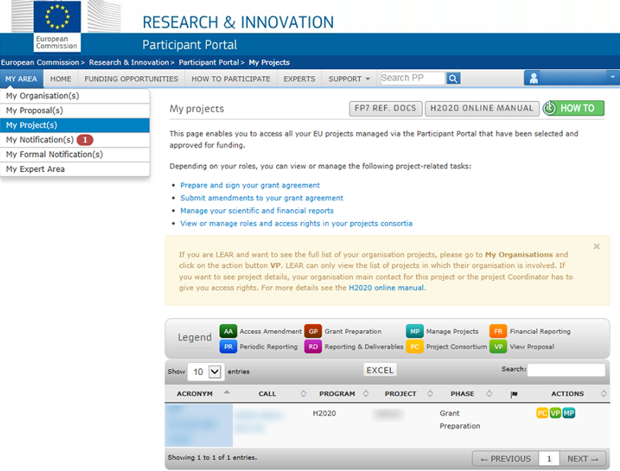


Go to “My Projects” section.
Then click on MP
icon to reach Participant Portal Grants Management
Services.
XXXXX
XXXXXX

Slide 8
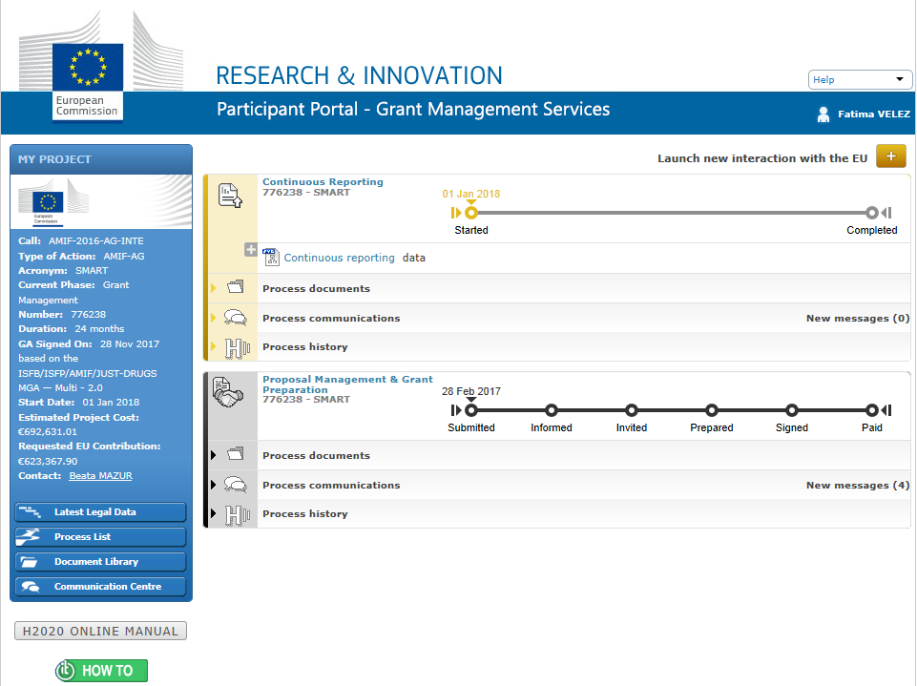
XXXXXXX
XXXXXX
XXXXXX
Continuous Reporting Module
XXXXXX
XXXXXXX
XXXXXX
XXXXXXX
XXXXXXX
XXXXXXXXX

Slide 9
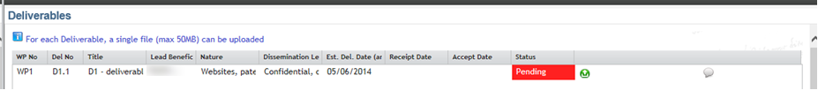
The status of the deliverable is 'Pending' when a deliverable hasn't been uploaded yet.
When the status is displayed with a red background ( ) this means that the estimated delivery date (due date) has passed.
Delivery dates can only be changed via an amendment.

Slide 10
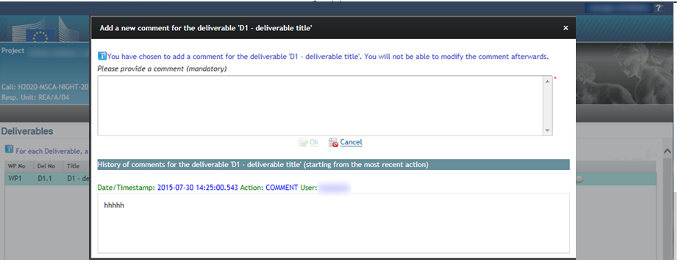
All co-beneficiaries can upload deliverables but only the coordinator can submit them.
Before submission a comment can be added and user is asked for confirmation whether s/he wants to submit.
Each time a deliverable has been submitted, the EU Officers will be notified.

Slide 11

EC tasks
Accept
Re-open: Consortium will be able to re-submit a new version. In case documents have to be added, the new submission shall contain the previous documents as well.
Reject: Consortium will not be able to re-submit a new version; costs related to deliverable will be ineligible
Beneficiary receives notification
Deliverables can be submitted after project end but periodic report (final report) cannot be submitted to the EU if not all deliverables have been submitted
Deliverables can still be re-opened by EC after submission of final report => suspension of payment delay

Slide 12
Beneficiaries’ tasks
Upload deliverables
Report on milestones (achieved? when?), critical risks (unforseen risks?)
Fill in publishable summary
Fill in information on publications (scientific), if applicable
Fill in information on dissemination and communication activities
Fill in information on trainings (Under development)
At submission of periodic (final) report, the IT tool captures info from continuous reporting module and creates automatically part A of your final technical report. Finalising the above tasks before project end saves you time afterwards.

Slide 13
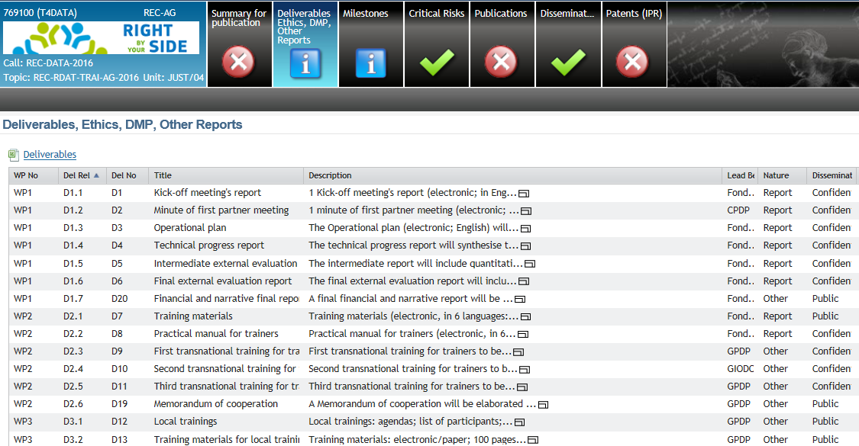

Slide 14
Periodic (Final) Reporting
Art. 15 + 16 GA
Final technical report
Overview of the implementation (part A)
Explanation of the work carried out (part B)
Quantitative reporting (Indicators)
b) Final financial report
Individual financial statements, containing
  Explanation on the use of resources
Summary financial statement – generated by the system
Certificate on the financial statements (if applicable)

Slide 15
Periodic Reporting
Overview of the implementation:
Information from continuous reporting module
Generated by the system
Part A of final technical report

Slide 16
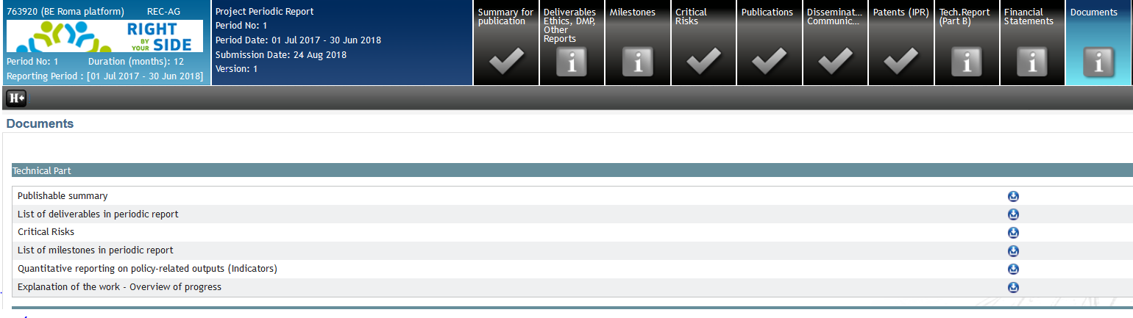
XXXXXXXXX

Slide 17
Periodic Reporting
Explanation on the work carried out (part B):
Template available in periodic reporting module
  (Always use this version)
Each beneficiary can contribute to the narrative report
Coordinator saves a single PDF file and validates
In case of changes => delete and upload again

Slide 18
XXXXXXXXX

Slide 19
Periodic Reporting
  Upload « Quantitative reporting on policy-related outputs (Indicators ) – template available at Reference documents page
Annex 3 to the Final Technical Report Quantitative reporting on policy-related outputs (Indicators)
Name of the Beneficiary/Coordinator:
Agreement number:
JUST/2015/
Project title:
1. Analytical activities
If the project includes analytical activities, indicate the type of documents/reports produced by your project:
Type of document / report: |  | Specify, if applicable:
 | 
 | 
 | 
 | 
 | 
 | 
 | 
 | 
 | 

Slide 20
Periodic Reporting / Financial Report
Each beneficiary completes online the individual financial statement including use of resources
Each beneficiary submits to the coordinator, signed by the beneficiary’s FSIGN
Coordinator checks and locks for review or sends back for changes
Only Coordinator can validate and submit to the EU
Within 60 days after project end (GA Art. 15.4)

Slide 21
Periodic Reporting
IT tool consolidates individual financial statements and generates a financial report which corresponds to the request for payment
Missing financial statements => ineligible costs

Slide 22
XXXXXXXXX

Slide 23
Financial Statement /
Use of resources
Expenses need to be detailed
How to?

Slide 24
Use of resources
Personnel costs:
Declare your direct personnel costs as actual costs
Supply data on the person/months per work package (not per deliverable)
At this stage, you do not need to provide details like names, level of experience etc.
Direct costs of sub-contracting:
Break down the total direct costs for the period into the costs for individual subcontractors

Slide 25
Use of resources
Other direct costs:
If costs are ≤ 15 % of the personnel costs you do not need to detail them
But you must still keep all the proofs you have of any costs you declare as eligible => audit
If costs are > 15 % of the personnel costs you must detail major cost items, apart from those that add up to less than 15 % of your personnel costs
Major cost items = starting from the cost item of highest value in terms of cost amount

Slide 26
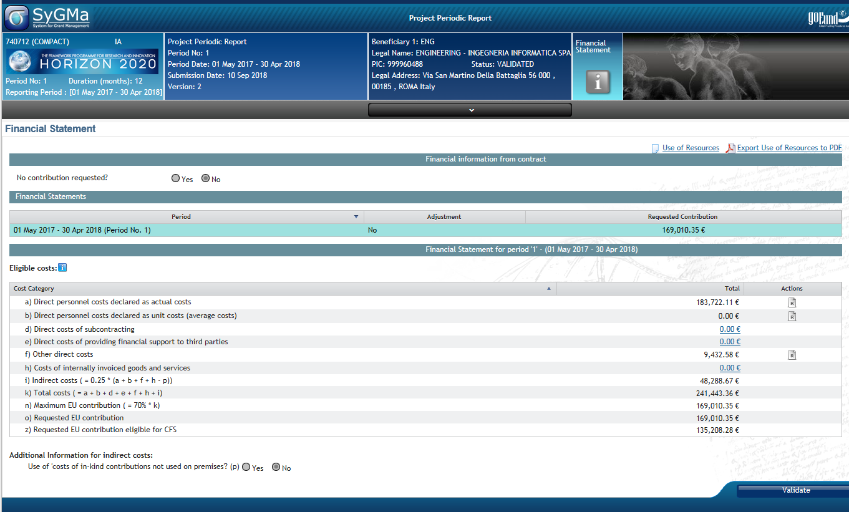
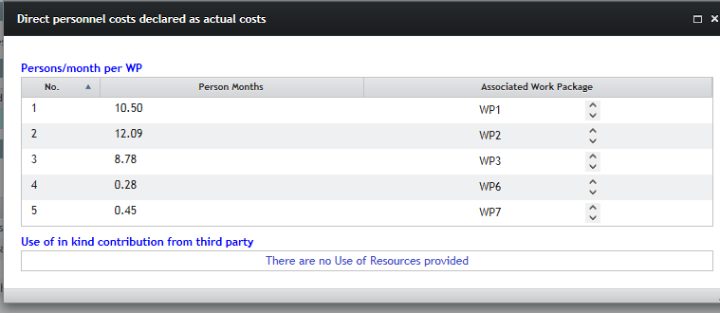
Use of resources

Slide 27

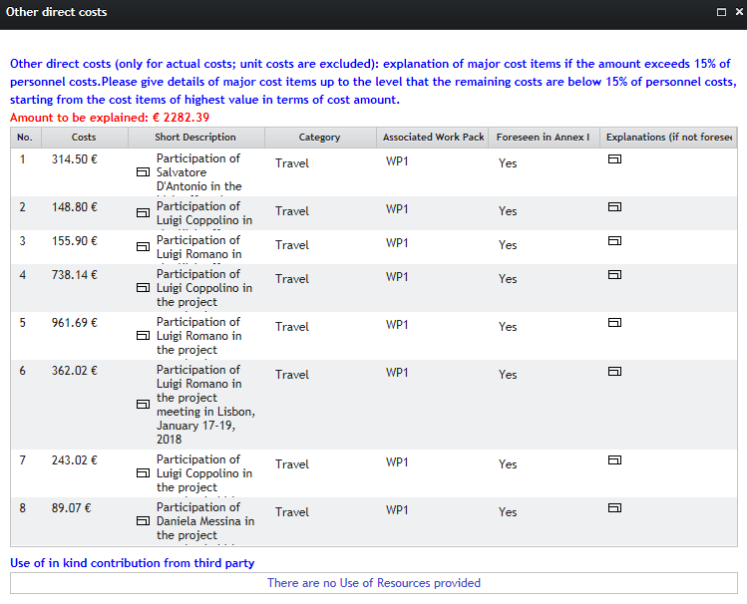
Use of resources

Slide 28
Use of resources /
Example
Personnel costs: € 15,632
Other direct costs: € 4,627.19
15 % of personnel costs: € 2,344.80 (no need to be justified)
Amount to be justified: € 4,627.19-2,344.80 = 2,282.39
Starting with the highest cost items

Slide 29
Certificate on Financial Statements
For each beneficiary, if
It requests an EU contribution of € 325,000 or more as reimbursement of actual costs and
The maximum EU contribution indicated, for that beneficiary, in the estimated budget (Annex 2 GA) as reimbursement of actual costs is € 750,000 or more
Template in Annex 5 of GA

Slide 30
Periodic reporting
EC tasks
Assess final report
Accept/re-open or reject deliverables which had not been submitted during project lifetime
May ask for additional information (payment delay stopped)
Pay final amount or recover pre-financing

Slide 31
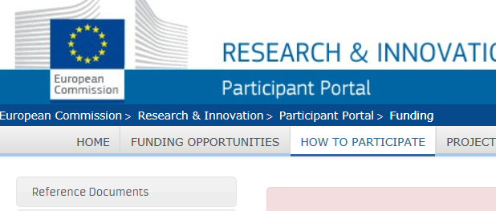
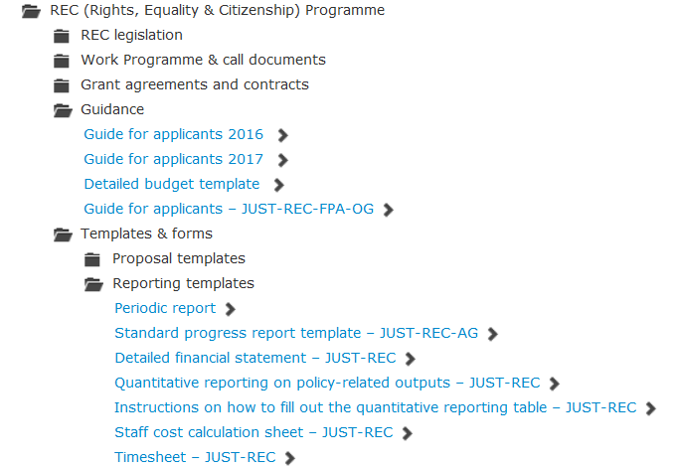
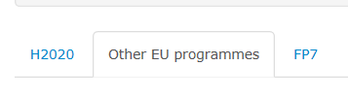
Templates
Participant portal → “How to participate” →“reference documents” → “other EU programmes” → "REC"
http://ec.europa.eu/research/participants/portal/desktop/en/funding/
Some templates
will be updated !
1
3
2

